Slide 1
RANDOM FOREST

Slide 2
1. What is Random Forest
Random Forest is a supervised ensemble machine learning algorithm that builds multiple decision trees and combines their outputs to produce a more accurate and robust prediction.
It works for both classification and regression.

Slide 3
2. Purpose
To improve prediction accuracy and generalization by reducing the overfitting and instability of individual decision trees.

Slide 4
3. Why it is Used
Reduces overfitting of decision trees
Handles non-linear relationships
Works well with high-dimensional data
Robust to noise and outliers
Provides feature importance

Slide 5
4. How Random Forest Works (Algorithm)
Core Ideas:
Bagging (Bootstrap Aggregation)
Random Feature Selection
Step-by-Step Algorithm:
Draw multiple bootstrap samples from the dataset
Train a decision tree on each sample
At every split, select a random subset of features
Grow trees independently and in parallel
Aggregate predictions:
Classification → majority vote
Regression → mean of predictions

Slide 6
5. Formula / Mathematical Intuition
Classification Prediction:
y^=mode{T1(x),T2(x),...,Tn(x)}
Regression Prediction:
y^=1n∑i=1/nTi(x)
Where Ti​ is the prediction of the i-th tree.

Slide 7
6. Technical Details
Ensemble Type:
Bagging-based ensemble
Tree Properties:
Trees are deep and unpruned
High variance, low bias individually
Ensemble reduces variance
Randomness Sources:
Data sampling (bootstrap)
Feature sampling at splits

Slide 8
7. Parameters
Model Parameters (Learned):
Individual tree structures
Split thresholds
Leaf predictions
Hyperparameters (Most Important):
Parameter | Description
n_estimators | Number of trees
max_depth | Max depth of each tree
min_samples_split | Minimum samples to split
min_samples_leaf | Minimum samples at leaf
max_features | Features considered per split
bootstrap | Whether sampling is with replacement
criterion | Gini, Entropy, MSE

Slide 9
8. Feature Importance
Random Forest estimates feature importance using:
Mean Decrease in Impurity (MDI)
Permutation Importance

Slide 10
9. Assumptions
No strict statistical assumptions
Assumes trees are weakly correlated

Slide 11
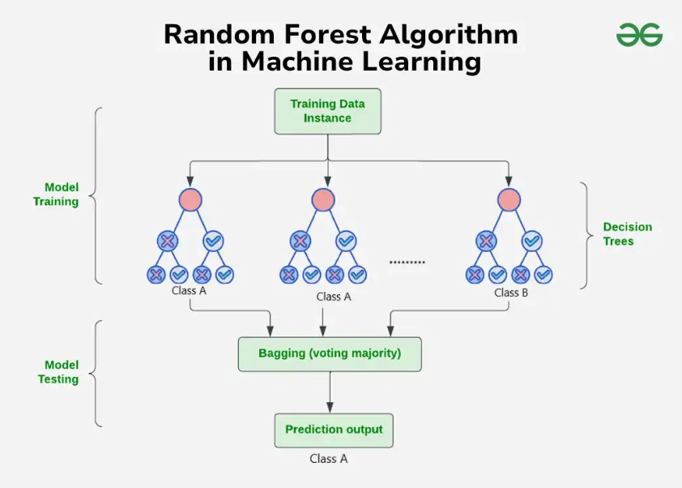

Slide 12
10. Pros
High accuracy
Handles non-linear data well
Resistant to overfitting
Works with missing values (some implementations)
Scales well with large datasets

Slide 13
11. Cons
Less interpretable than single trees
Computationally expensive
Slower inference
Large memory usage
Feature importance can be biased

Slide 14
12. Real-World Applications
Finance:
Credit scoring
Fraud detection
Healthcare:
Disease prediction
Risk stratification
Marketing:
Customer churn prediction
Recommendation systems
Engineering:
Fault detection
Predictive maintenance
ML Pipelines:
Baseline model for tabular data
Feature selection

Slide 15
13. Random Forest vs Decision Tree
Aspect | Decision Tree | Random Forest
Overfitting | High | Low
Stability | Low | High
Accuracy | Moderate | High
Interpretability | High | Medium
Training Time | Fast | Slower

Slide 16
Summary
Random Forest is a bagging-based ensemble of decision trees that achieves high accuracy and robustness by averaging multiple uncorrelated trees.

